Slide 1
Voice of America
Persian Mobile App Comparative Analysis

Slide 2
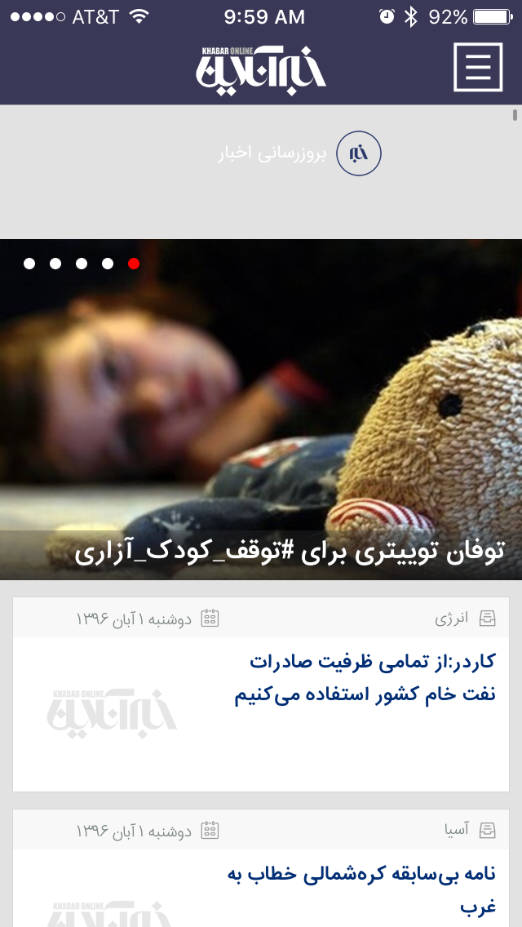
KhabarOnline

Slide 3
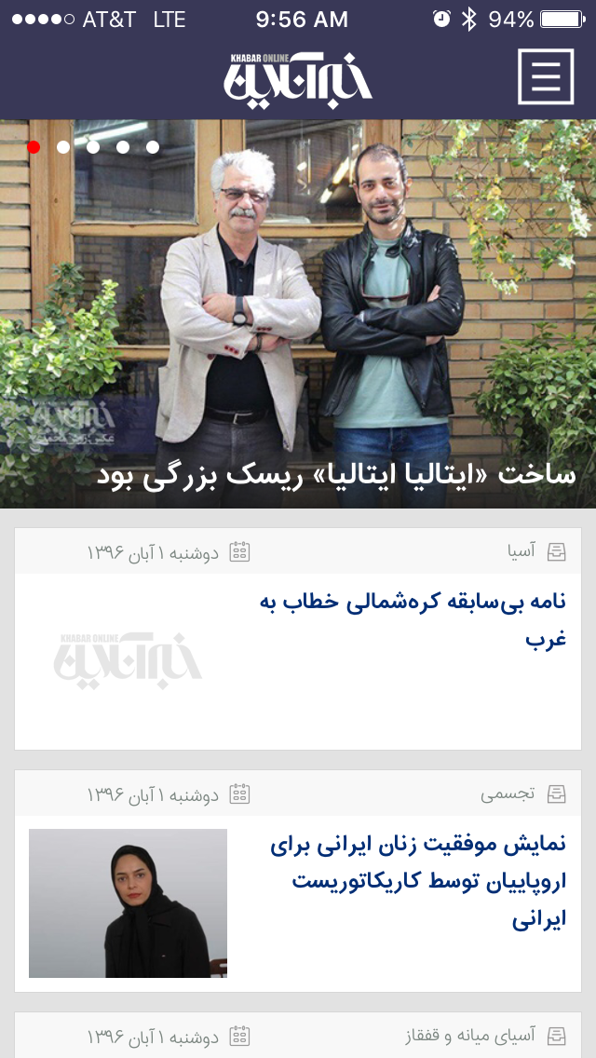
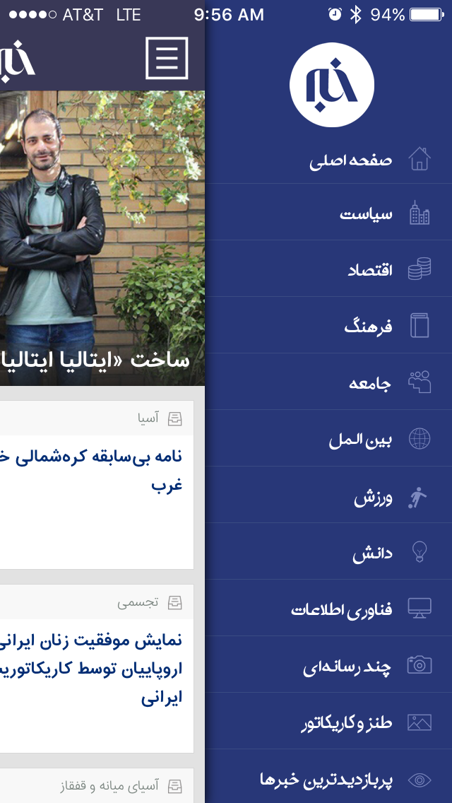
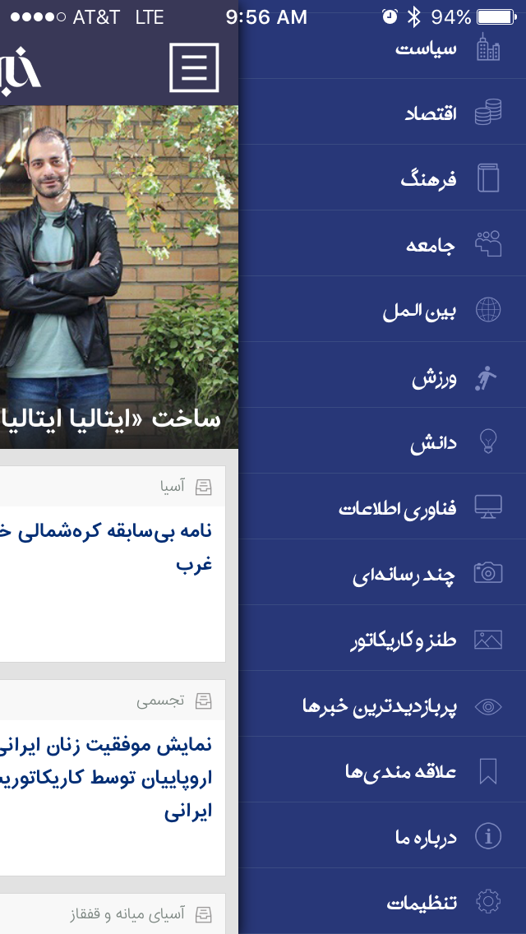
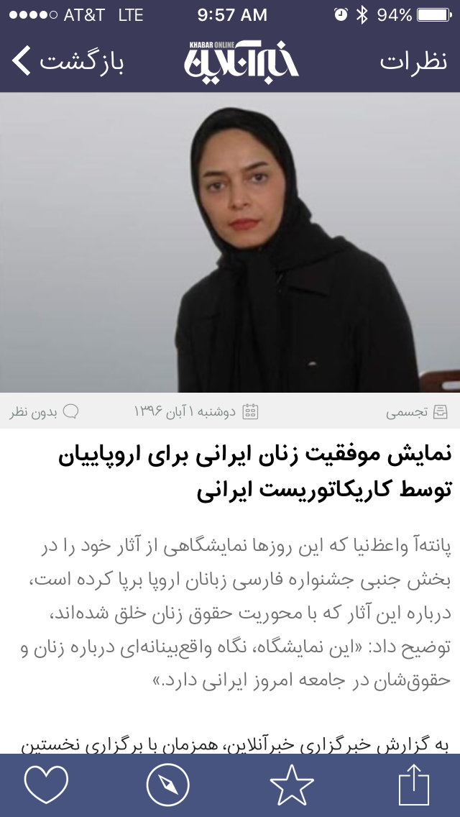
KhabarOnline: Home Screen
1
2
3
4
5
6
7
8
9
10
11
12
10
11
12
13
14
15
Like Web Favorite Share
Home Screen
Hero image has title in white in lower third. Clicking it goes to text with image content above.
Grey content on upper left of card is date, right is the category
Dark blue is the headline
Not all articles have images if not available. Could potentially shorten the height of the card if no image available.
Menu
Home screen
Politics
Economy
Culture
Society
International
Sports
Science
Tech
Multimedia (on-demand video)
Cartoons
Top rated
Driven by most favorited, commented, & viewed
Add to Favorites
About Us
Settings
Turn on/off notifications for breaking news
Article Screen
Grey text just below image:
Comments
Red icon if there are comments
Includes the number of comments
Calendar date and time
Category
Black text is headline
Light grey is the lead (summary)
Medium grey is content
Sharing is through iOS
Categories

Slide 4
KhabarOnline Key Findings
Home Screen
Four ”hero” images plus indicator
Personal Settings
Self-identification for personalized content
Enable cellular download
Enable push notifications
Share the app
Send Feedback
Categories
No control over Category prioritization
Users have the ability to comment on all text articles and multimedia
limited number, no infinite scroll or update load at bottom
No ”audio-only”
Navigation
No header or footer
Menu is right-hand nav
Personal settings only include setting notifications for breaking news on/off
Swipe left from within content to return to Home / Category landing page
Video Player
Uses the device video player and controls

Slide 5
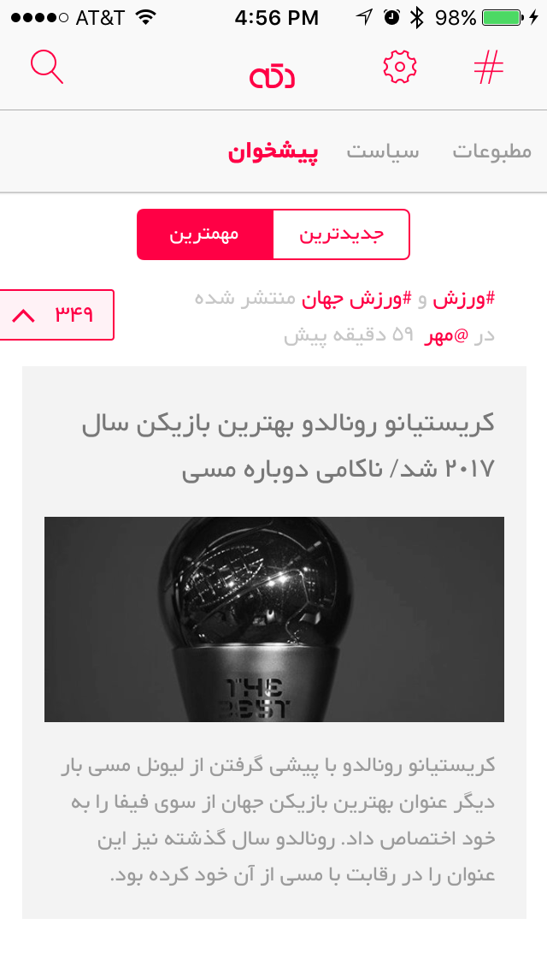
Dakke
Dakke has no splash screen

Slide 6
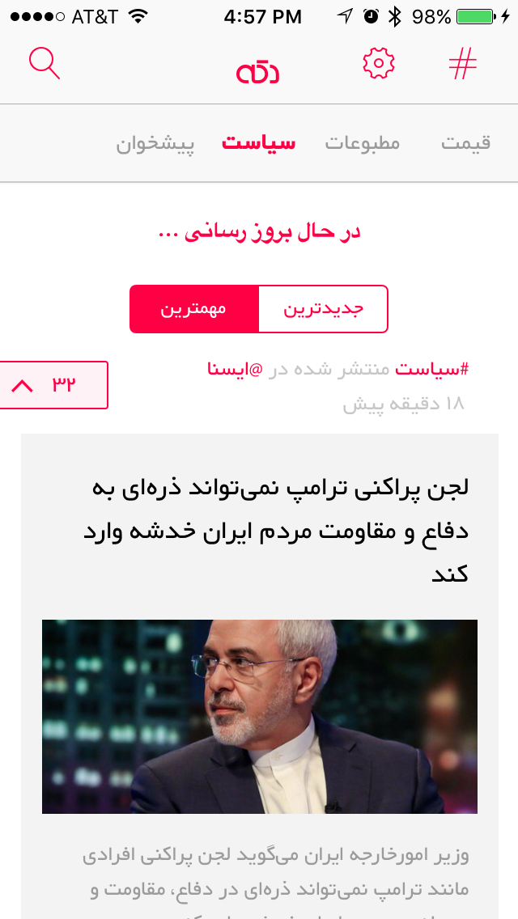
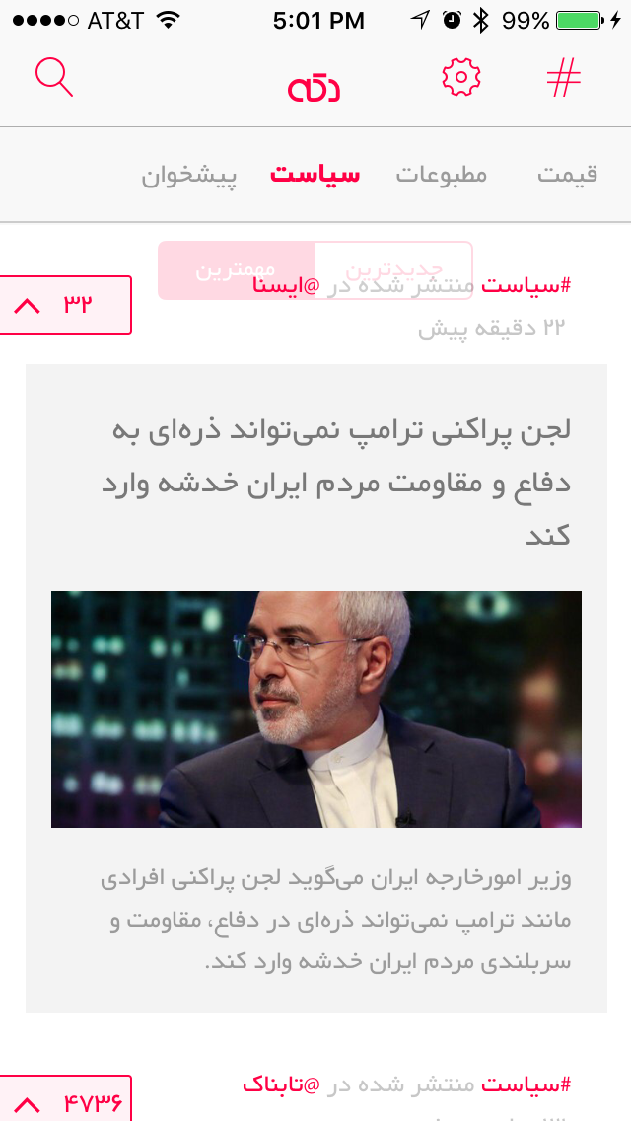
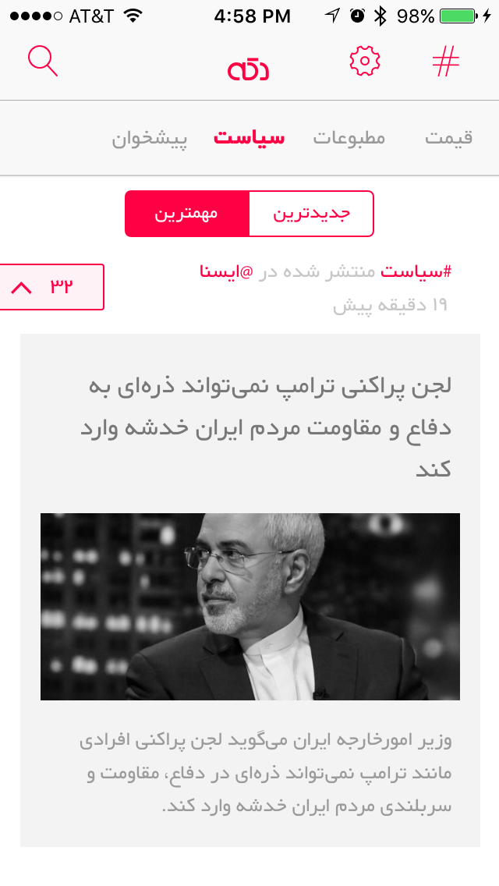
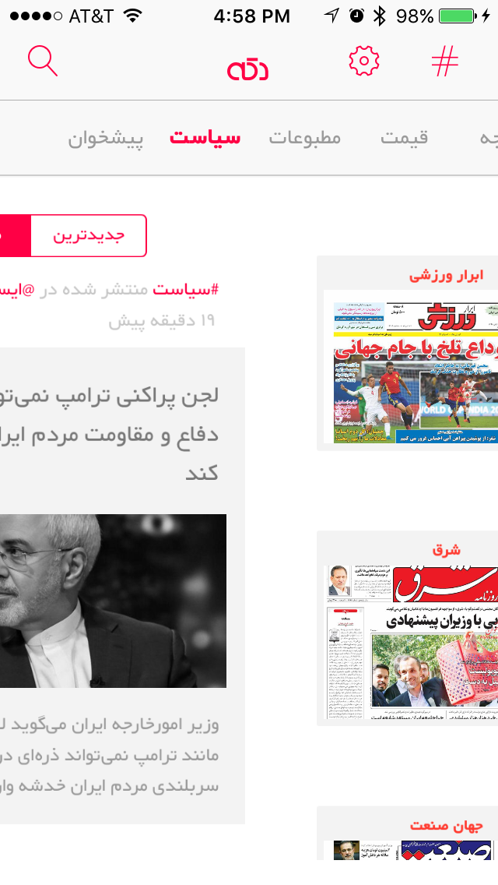
Dakke: Home Screen
Home Screen
First category (not selected) is “Peeshkhon” (top headlines from all different sources)
Swiping down loads new content
Two tabs switch between “Newest” and “Most Important”.
Scrolling up forces two tabs to disappear
Scrolling back down has them reappear
Once an article has been viewed, the thumbnail images turns to black and white
Category Navigation
Swiping left from Home / Category landing page or from Category nav bar transitions the displayed content and the nav to next category
If user has scrolled down in a particular category, leaves that category, then returns, the user’s place is saved

Slide 7
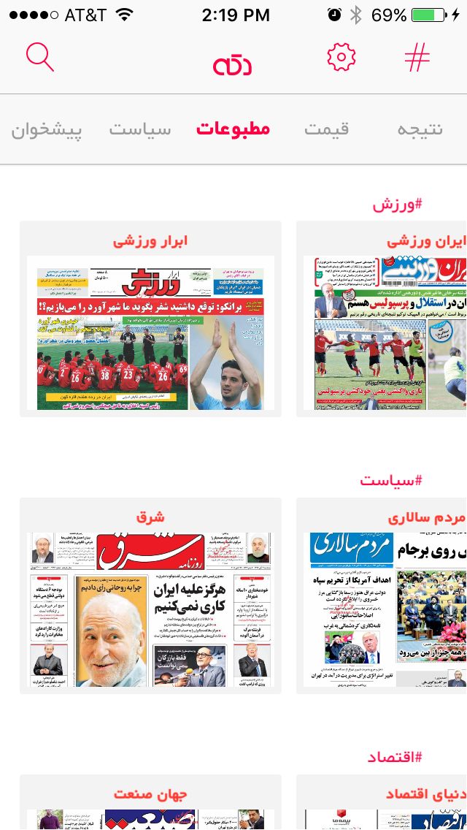
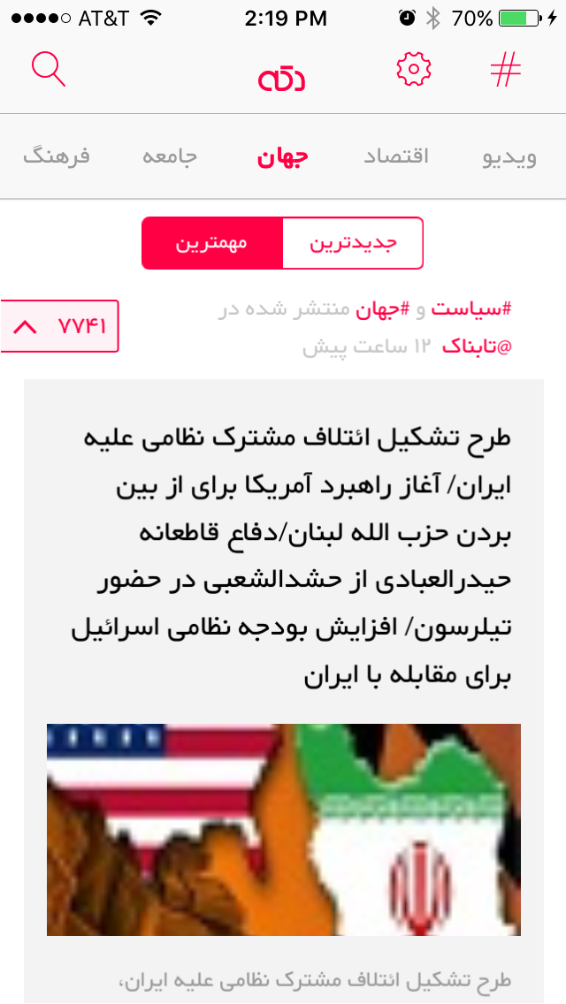
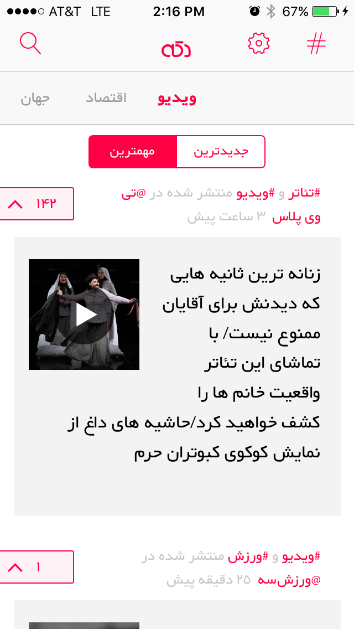
Dakke: Navigation and Categories
Top Nav
Search
Dakke Home button
Settings
# is link to Category lists
Categories
Headlines
Politics
Press – Peeshkhon
Currency Exchange including gold
Prices fluctuate a lot
Sports Results
Technology
Sports
Culture / Entertainment
Community / Society
World News
Economy
Video
Video
Uses iOS video player
Two tabs switch between “Newest” and “Most Important”.
Red up caret – click it to “Like”
Red and grey text are tags
Categories, has video
Video thumbnail with teaser

Slide 8
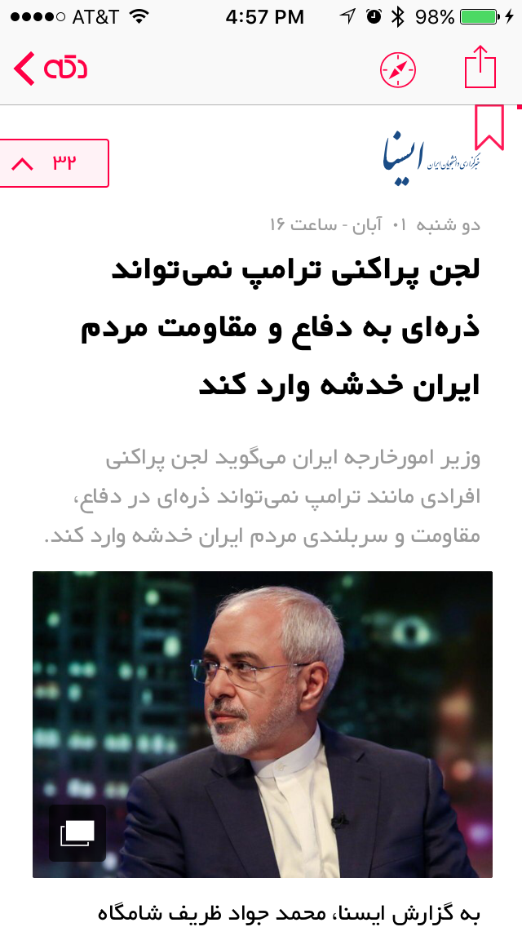
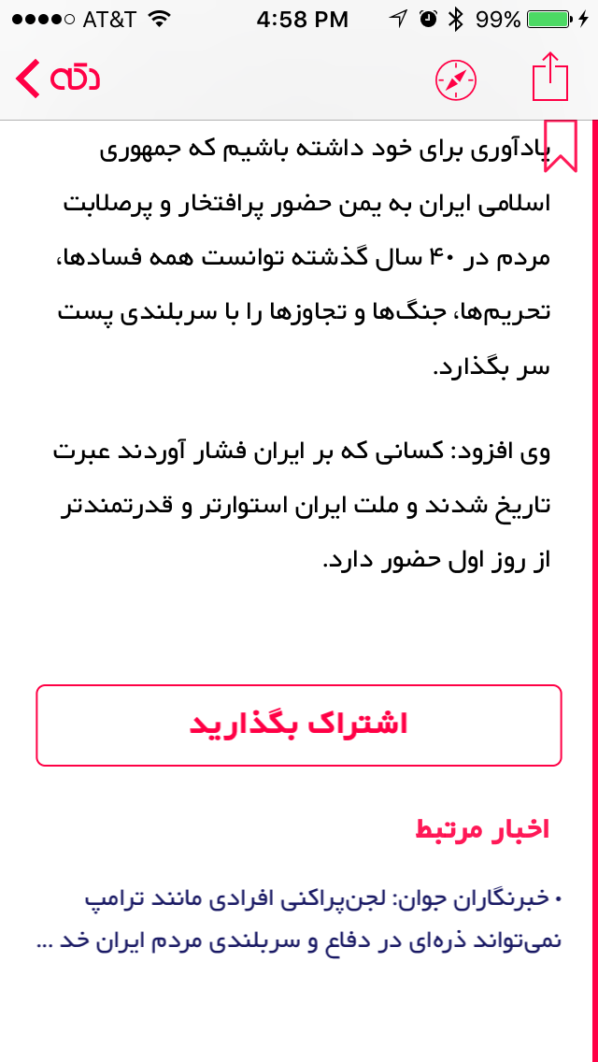
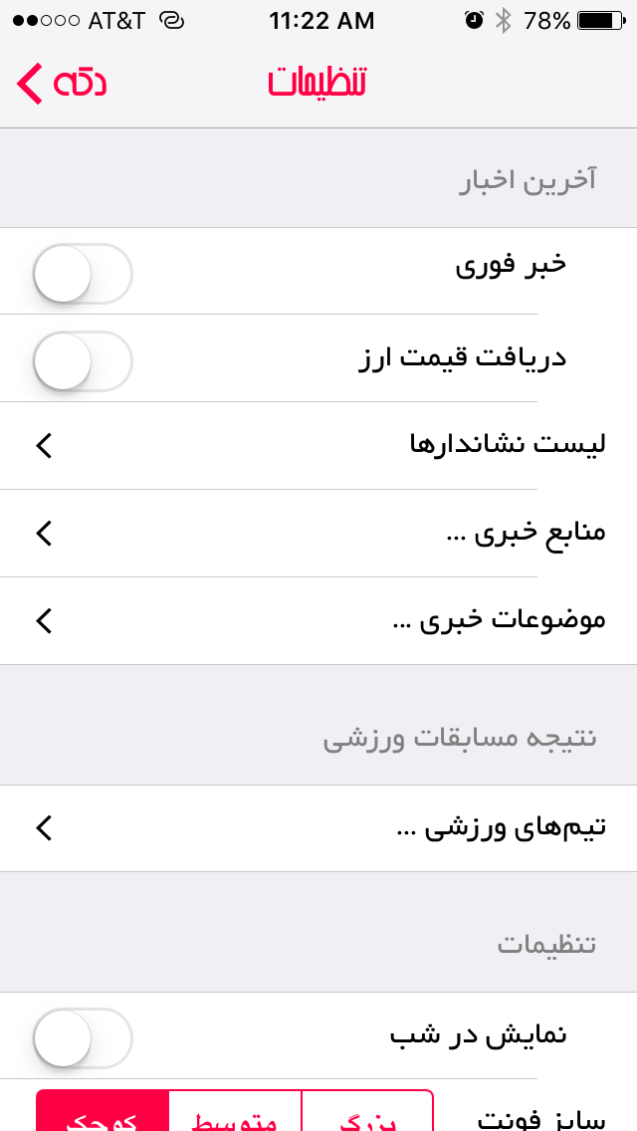
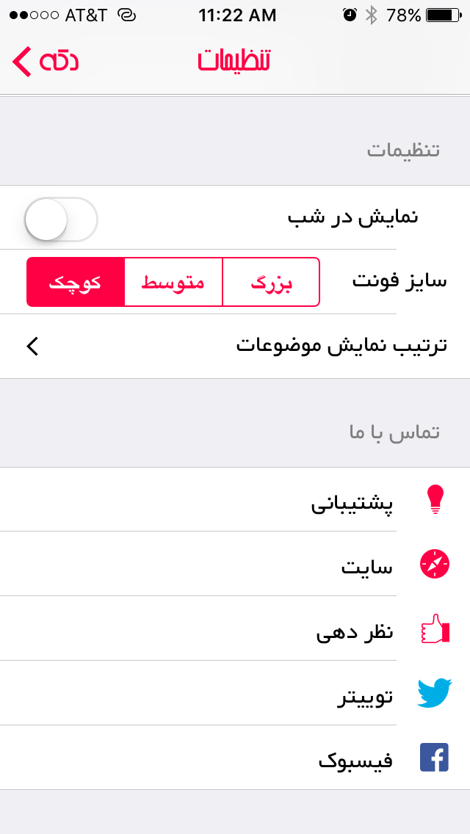
Dakke: Article Screen and Settings
Article Screen
Compass takes user to original source site
Red up caret – click it to “Like”
Blue text in upper right is source
Light grey is date / time
Dark black is headline
Light grey teaser
Image
Black text is body of article
Link to the top left “Dakke” goes back to Home / Category landing page
Animation move Dakke from upper left to center
Red box is for iOS sharing – same as upper right
Settings
Turn on/off notification for Breaking News
Turn on/off currency exchange change notification
#3 empty
Sources of news – agencies
Choose categories
-- Results for sports matches -–
Choose which teams to follow
-- Visual settings –-
Brighter at night
Font size small / medium / large
Choose Home screen
--- Contact Us –-
Email Support
Dakke Web Site
Rate the app
Open Dakke Twitter
Open Dakke Facebook

Slide 9
Dakke Key Findings
Home Screen
All content screens have tabs for Most Recent and Most Important content
Scrolling up forces two tabs to disappear – scrolling down they reappear
Once content is viewed it thumbnail turns to black and white
Categories
Peeshkhon allows user to see quick glance of headlines and teasers – this could be a Home screen view option
Currency exchange rates and Sports results are included here
Navigation
Swiping left / right moves the Category nav as well as the content column to the next category
Content
Users have the ability to “Like” and to share content
None of meta data is overlaid on thumbnail
Personal Settings
Visual settings such as:
Brighter at night
Font size small / medium / large
Choose Home screen

Slide 10
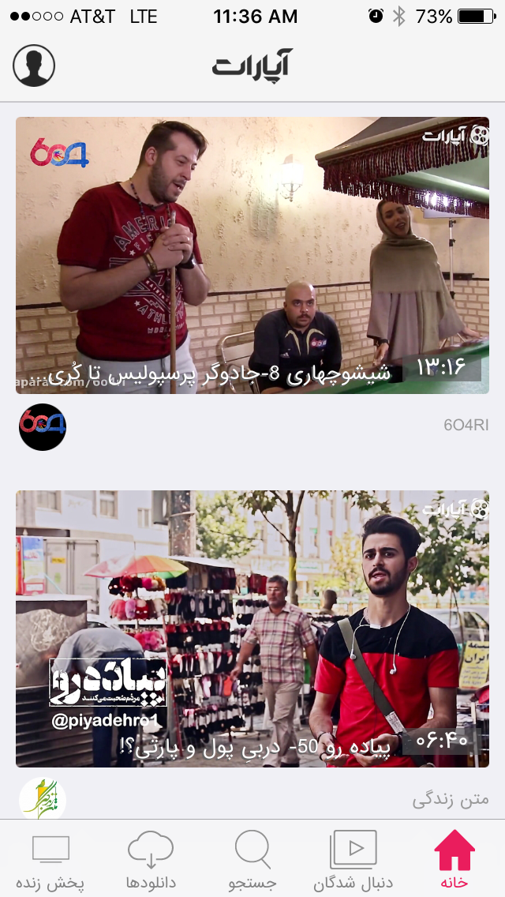
Aparat Iranian YouTube
Aparat has no splash screen

Slide 11

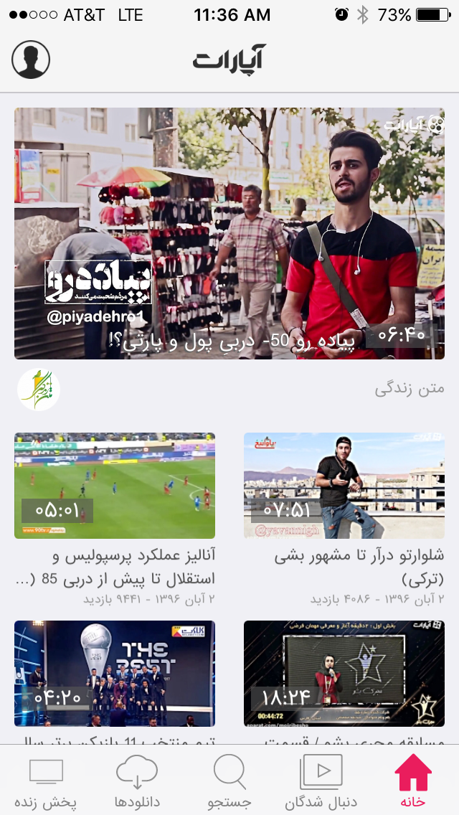
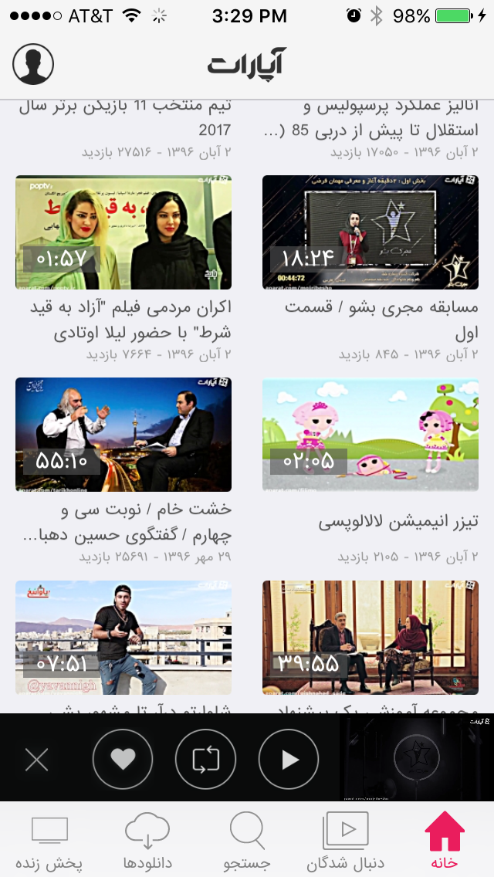
Aparat: Home Screen
Profile
Sign in
Register
Swipe left brings user back to Home screen
Home
Two prioritized videos
Second video is promoted content from Aparat
White text overlay is title and duration
Light grey below and right is name of uploader
Left icon is uploader’s avatar
Links to all their uploaded content
Link to follow them
Scroll Down
Secondary videos are side by side
White text overlay is duration
Dark grey is title
Light grey is date of upload and number of views
Footer stays static
When a video is playing, user can swipe down to collapse player (black bar) with options:
Close
Like
Share
Login
Register
Cancel
Play
Watch tiny video as it plays – shows loading animated gif if video is loading

Slide 12
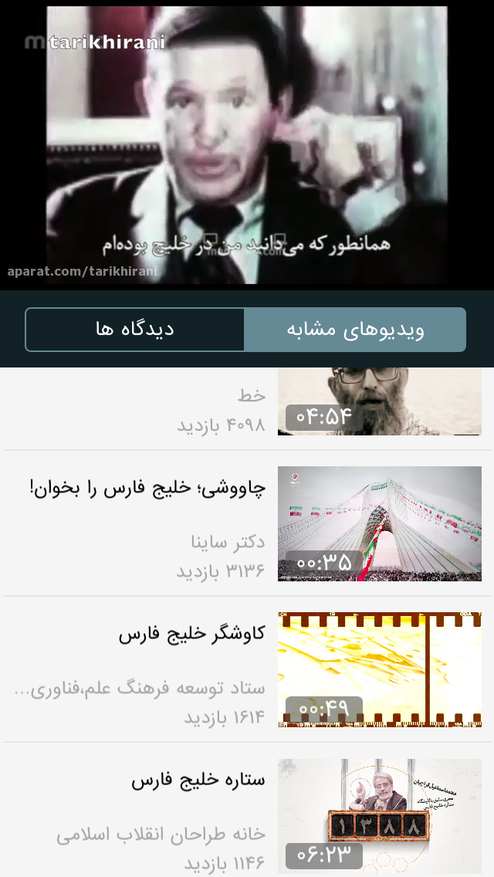


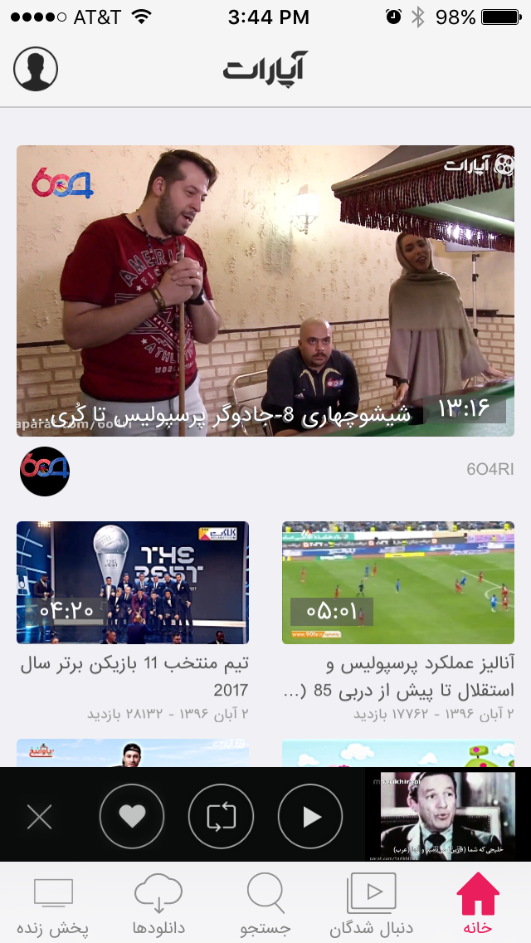
Aparat: Video Player
Video Player
The very first time a user clicks a video, they are prompted to set their preferred resolution
Two options
Related videos (shown)
Comment
Swiping related videos down reveals more meta data of current video
White text below is title
Grey text is number of views and date
White caret on left gives more detail
Ellipse
Allow user to report inappropriate content
iOS Share
Download
Like
Aparat share
Red box – follow uploader
White text is uploader’s name and avatar
Clicking video reveals video options and transport
Down caret and swipe down minimizes player
HD gives various video resolution options
Circular arrow gives recent video history
Diagonal arrows in lower left of video forces video into full screen landscape
When a video is playing, user can swipe down to collapse player (black bar) with options:
Close
Like
Share
Login
Register
Cancel
Play
Watch tiny video as it plays – shows loading animated gif if video is loading

Slide 13
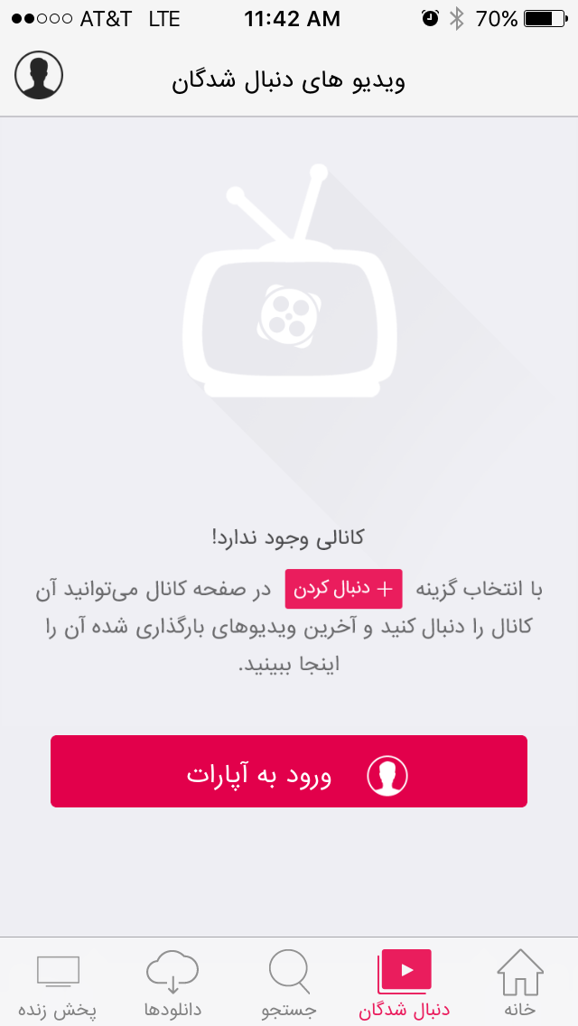
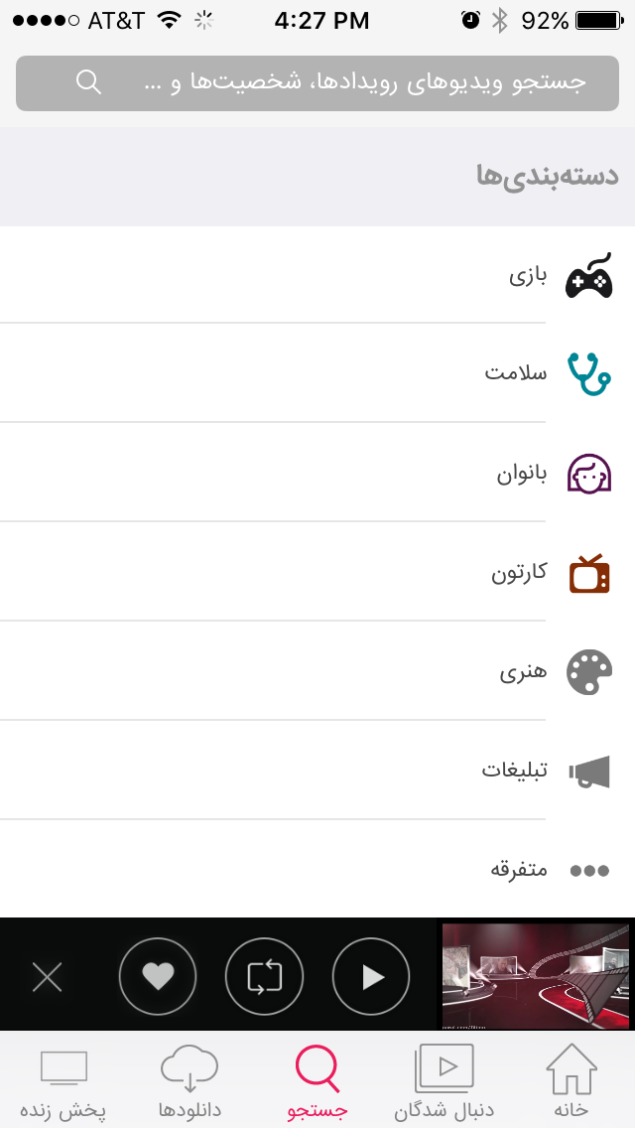
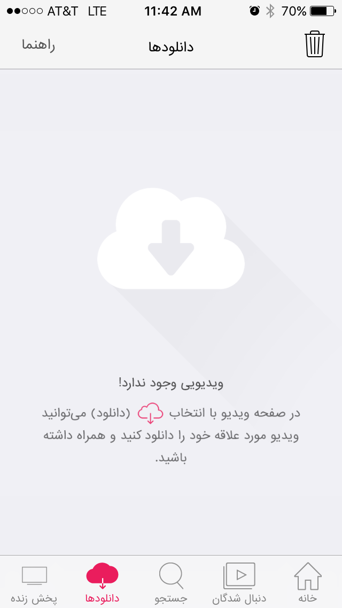
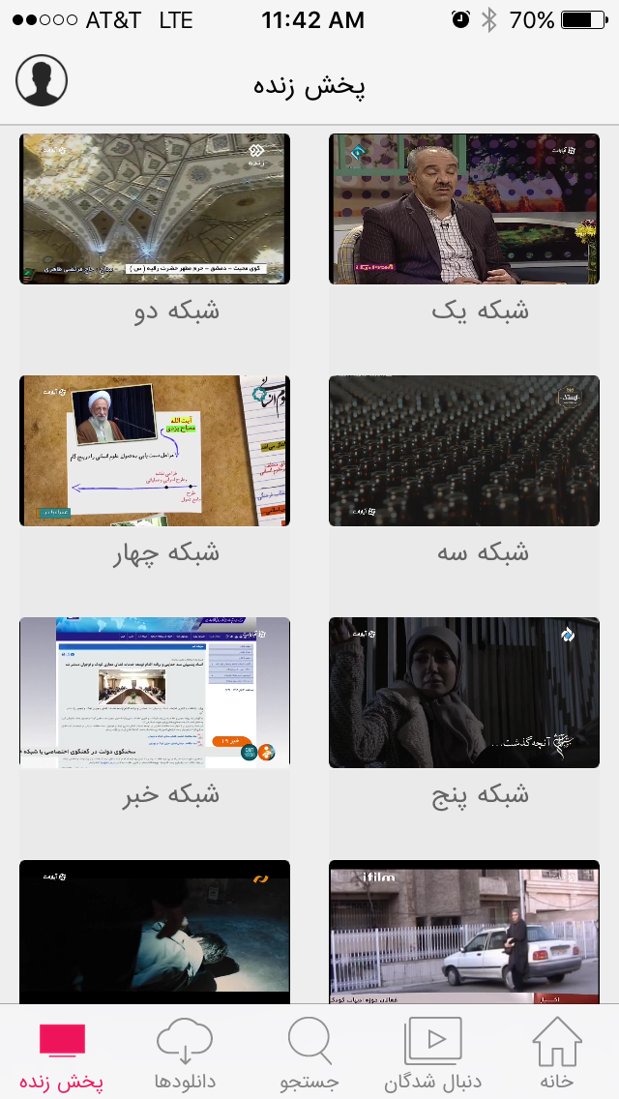
Aparat: Other Screens
Follow
Enter in particular hashtags (from within Aparat app) users want to follow
Prompts user to log in / register
Shows list of videos from that uploader
Search / Categories
List of popular Categories (sub-header):
Game
Health
Women
etc.
No way to edit or prioritize categories
Download
Store videos locally
All Iranian TV
Channel 1, 2, 3, etc.
Uses iOS video player

Slide 14
Aparat Key Findings
Video Player
Allows user to collapse player and continue browsing
Multiple options from within player screen to access related content, comment, change resolution, share, Like, download,
The very first time a user clicks a video, they are prompted to set their preferred resolution
Categories
Limited Category customization
Navigation
Almost all navigation is at the bottom within thumb reach
Footer stays static when scrolling through content
Personal Settings
Requires login

Slide 15

The Best

Slide 16
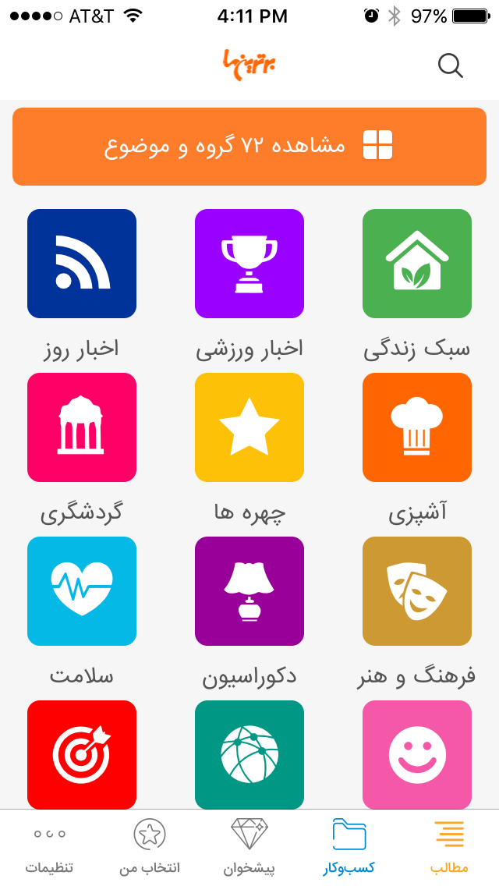
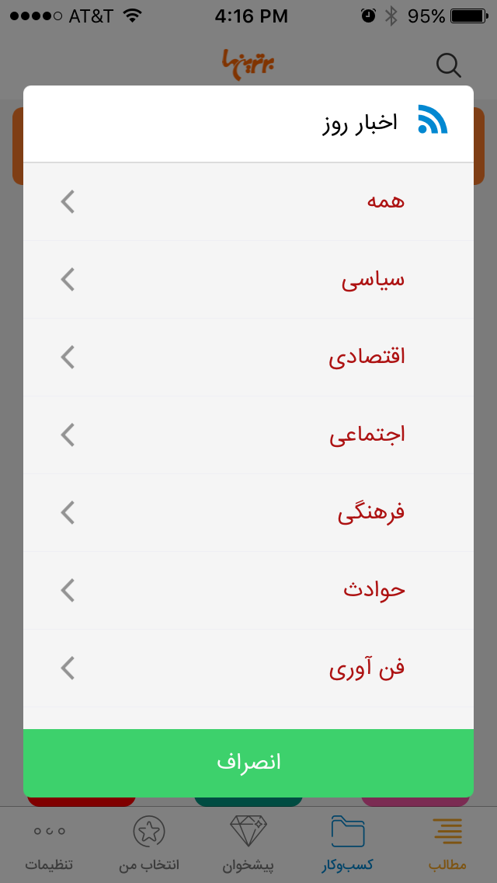
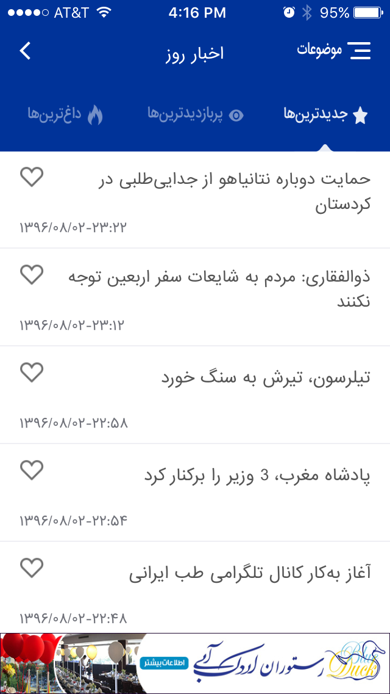
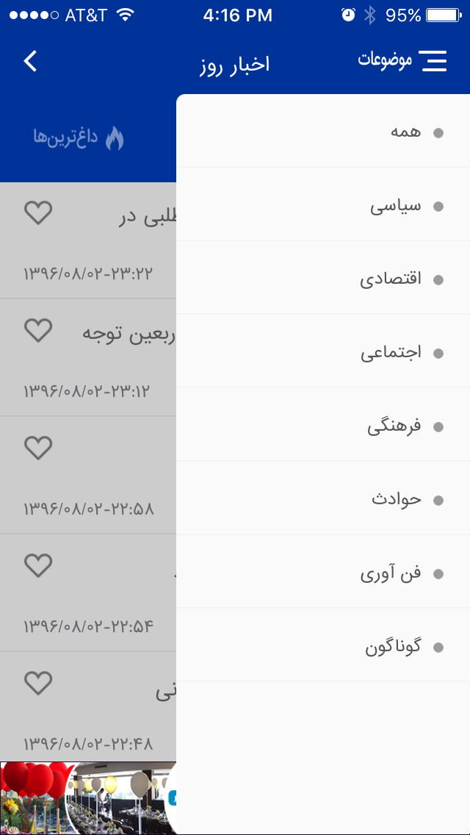
The Best: Home Screen
Home Screen
News of the Day
Sports
Lifestyle
Tourism
Celebrities
Cooking
etc.
Main navigation is at the bottom of the screen within thumb reach but only on main landing pages
See all 72 Categories
First option = “All”
News of the Day
Top Nav:
Star = Newest
Eye = Most Read / Watched
Flame = Hottest topics
Driven by # of Likes
List of articles by date
Sub-categories
Navigation to sub-categories just for that category

Slide 17
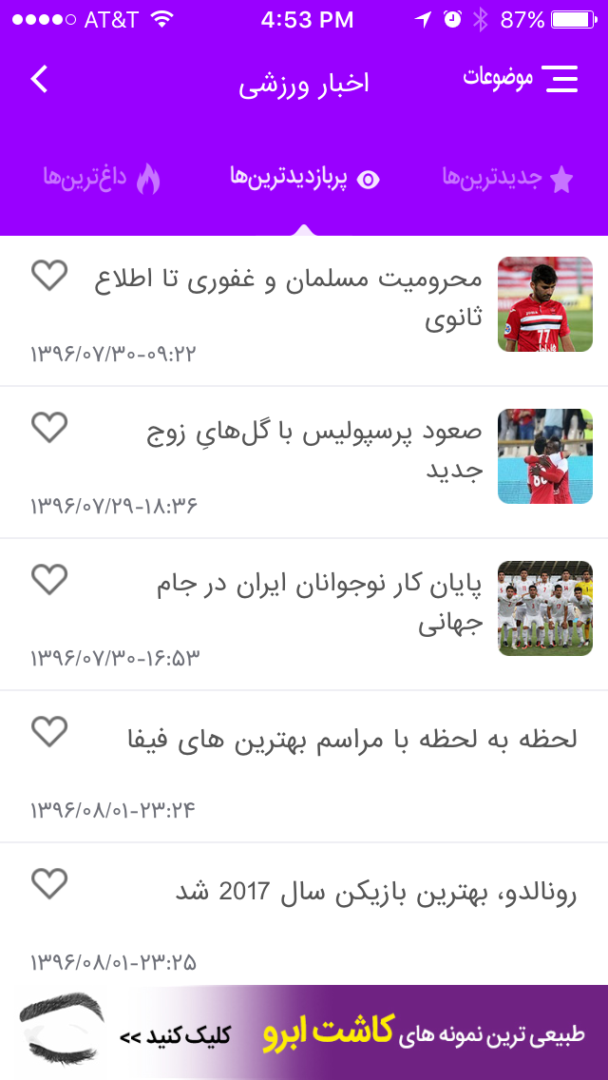
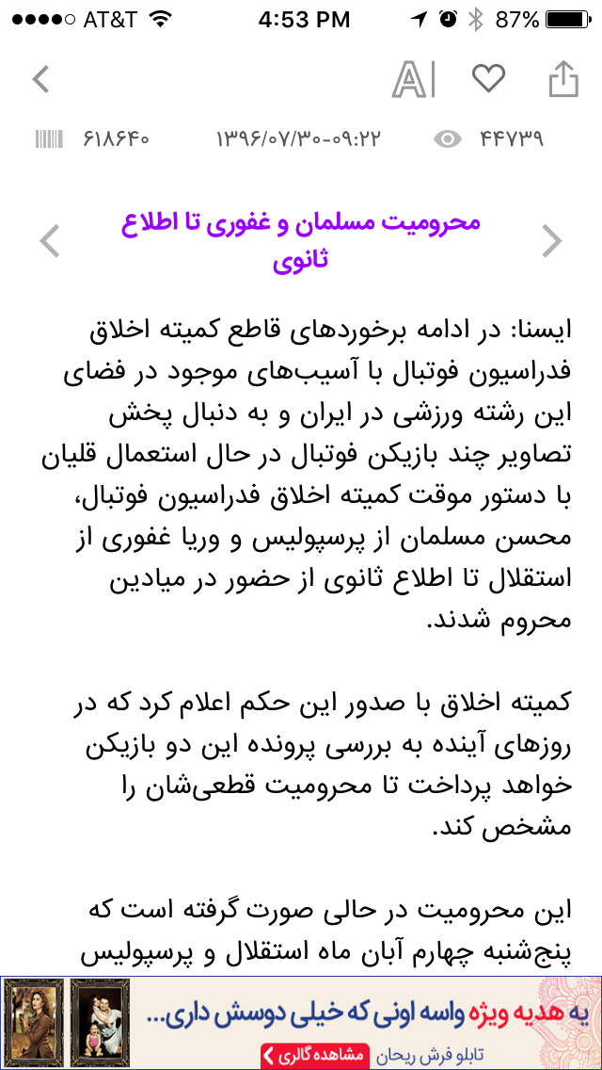
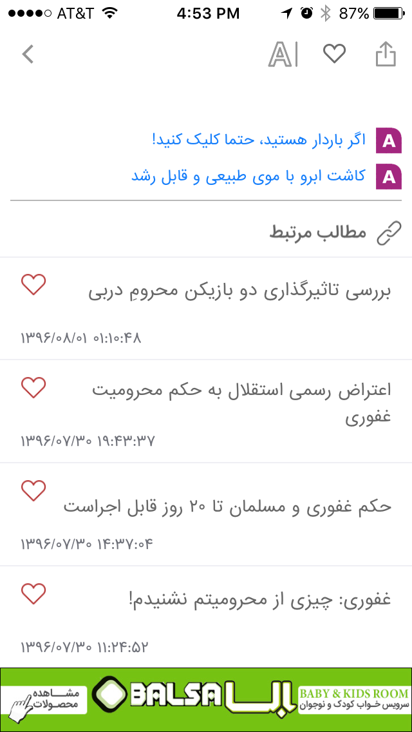
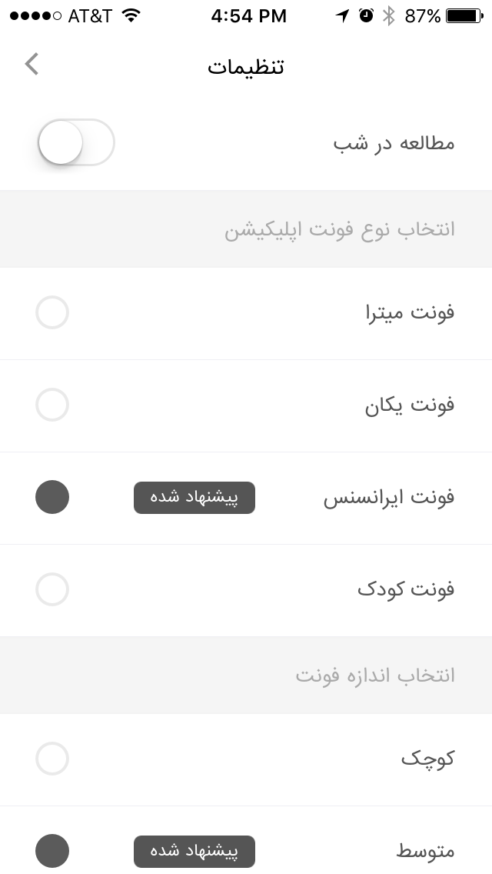
The Best: Category & Content Screens
Sports Screen
Same top nav as other categories
Star = Newest
Eye = Most Read / Watched
Flame = Hottest topics
Driven by # of Likes
Content Screen
Barcode = numerical code for article – similar to byline
Time / Date
Number of views
Purple text = title of current article
Arrows navigate to previous/next article
Comments and Related Content
Includes at the bottom links to related content
Orange box (not shown) allows commenting
Settings for Viewing (AI)
Reading at night – changes to black background and brightness
-- Choose your font
four font choices
-- Size
small / medium / large
-- Temporary memory (not shown)
trash = clear cache

Slide 18
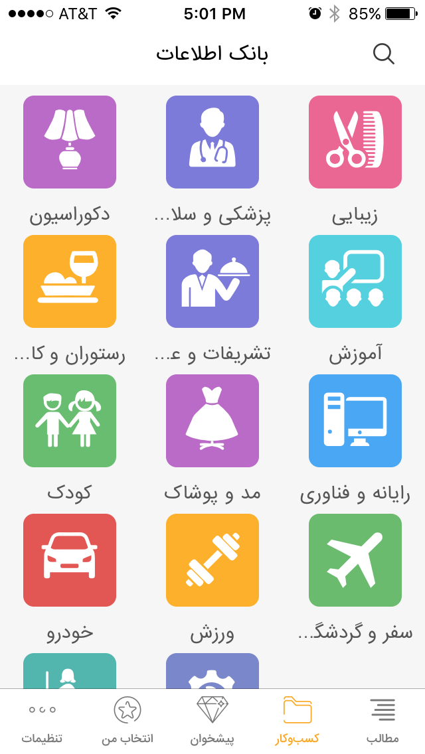
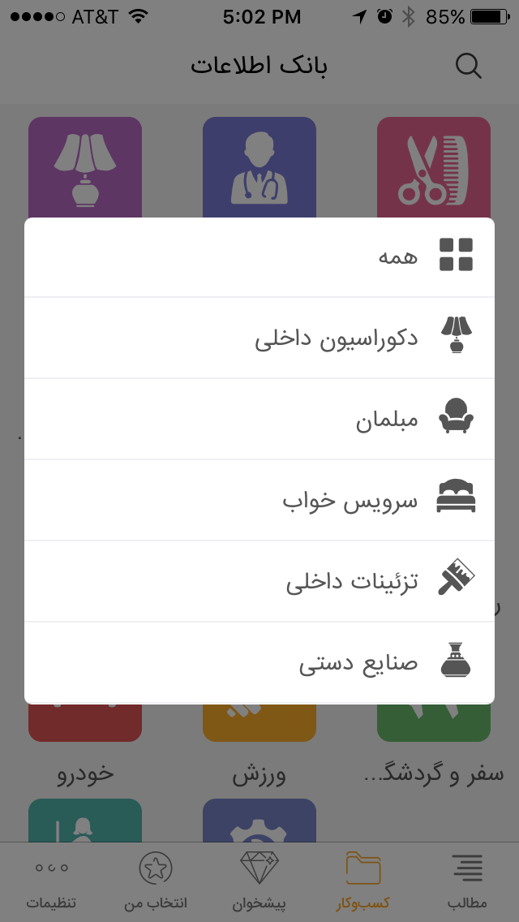
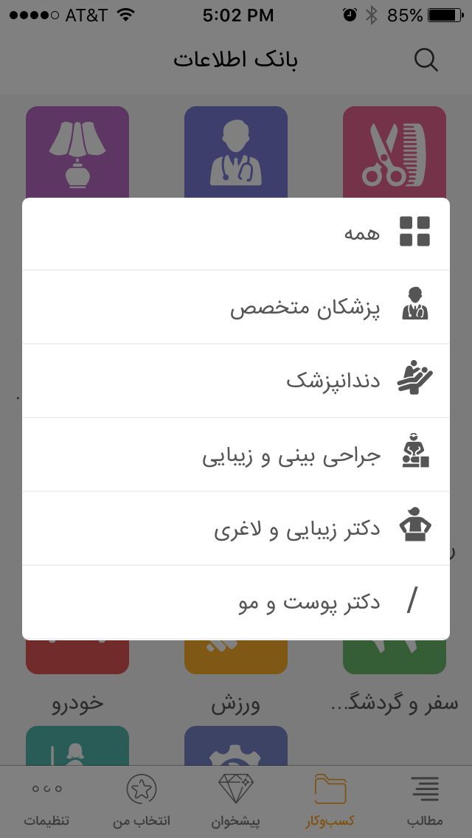

The Best: Business Directory
Business Directory Screen
Database of numbers / addresses
(Yellow Pages)
Housewares
Medical
Barbers
etc.
Sub-categories
Modal for choosing sub-categories
Inconsistent experience but a possibly good solution for navigating to sub-categories
Medical
Navigate to different medical professionals
Search
Search input box
Orange box = execute

Slide 19
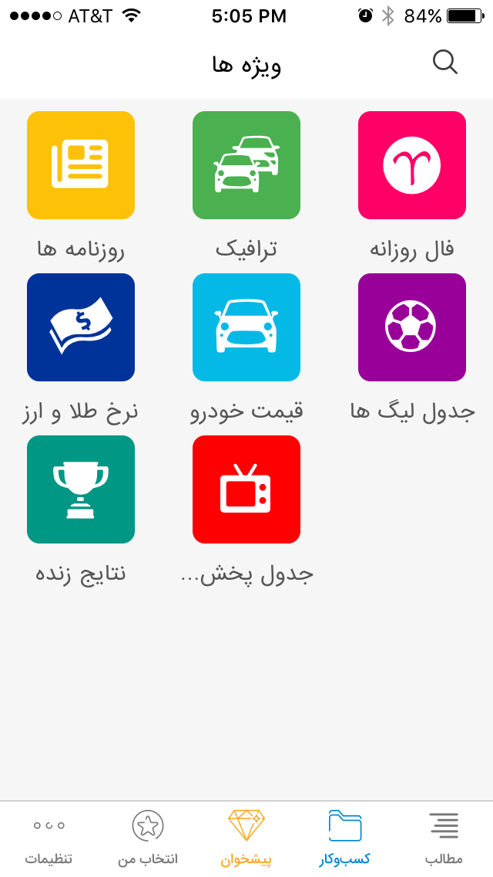
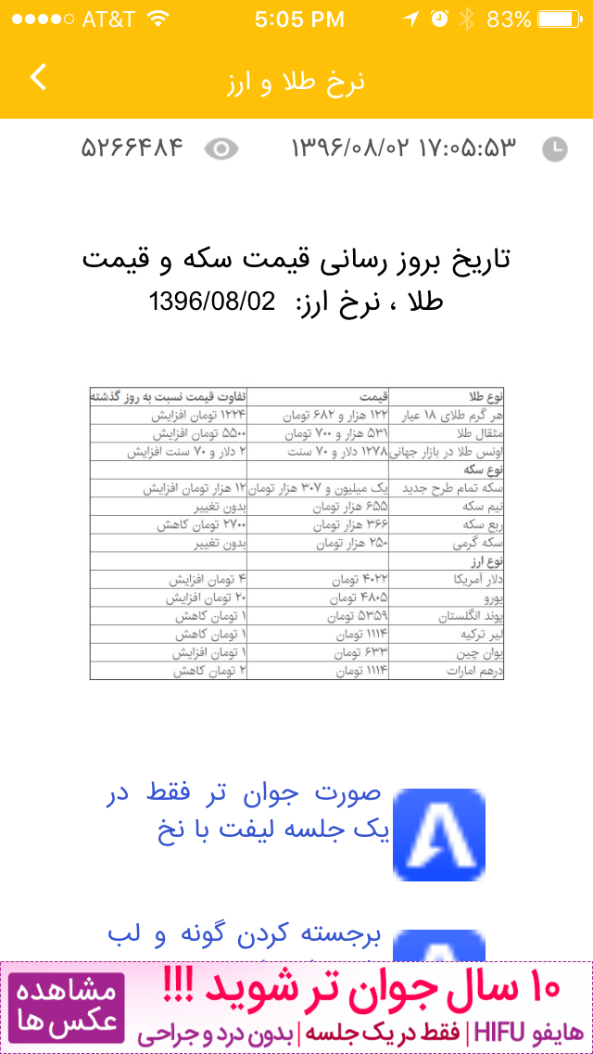
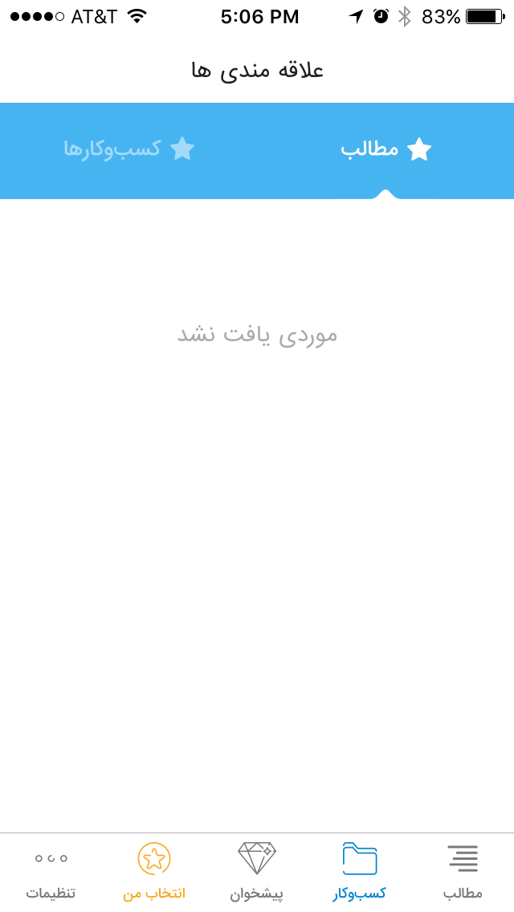
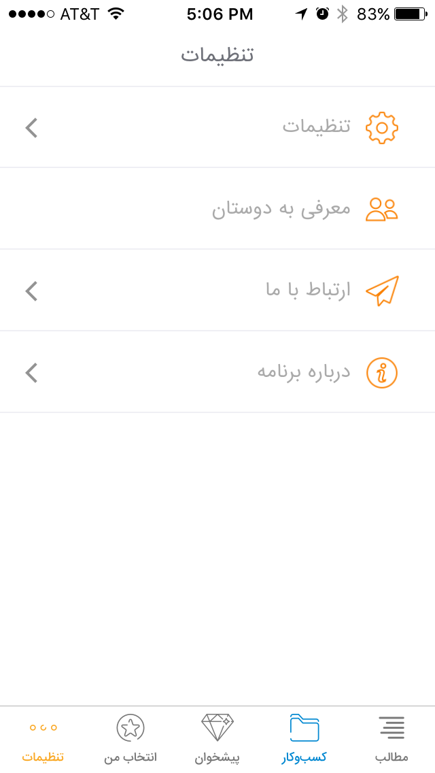
The Best: Other Screens
Peeshkhon Screen
The Diamond icon refers to “Discover” – this is also used in Farsi apps
Horoscope
Currency
Traffic
etc.
Currency Exchange
Favorites
Right tab = News articles
Left tab = Yellow pages
Settings
Settings
Goes back to Settings for Viewing (AI) modal
Introduce us to Your Friends
Contact Us
About

Slide 20
The Best Key Findings
Articles
When reading article content there is navigation to go to next/previous article
Personal Settings
Allows users to set night-time viewing, fonts, and font size
Categories
“Hot” content is driven by the number of “Likes”
The Yellow Pages section has a pop-up modal for choosing sub-categories (inconsistent experience from articles)
Navigation
Main navigation is at the bottom of the screen within thumb reach but only on main landing pages
Uses a “Diamond” icon for discovering new content
Categories have a dedicated hamburger for navigating its sub-categories
Personal Settings
Includes an “Introduce us to your friends” button which would enable users to share the app over NFC

